Slide 1
Technical Writing Workshop
From Ideas to Documents
Fadia Elissa

Slide 2
Agenda
Puzzle Competition
Report Writing
Graph/Table Description
Start Working- Template

Slide 3
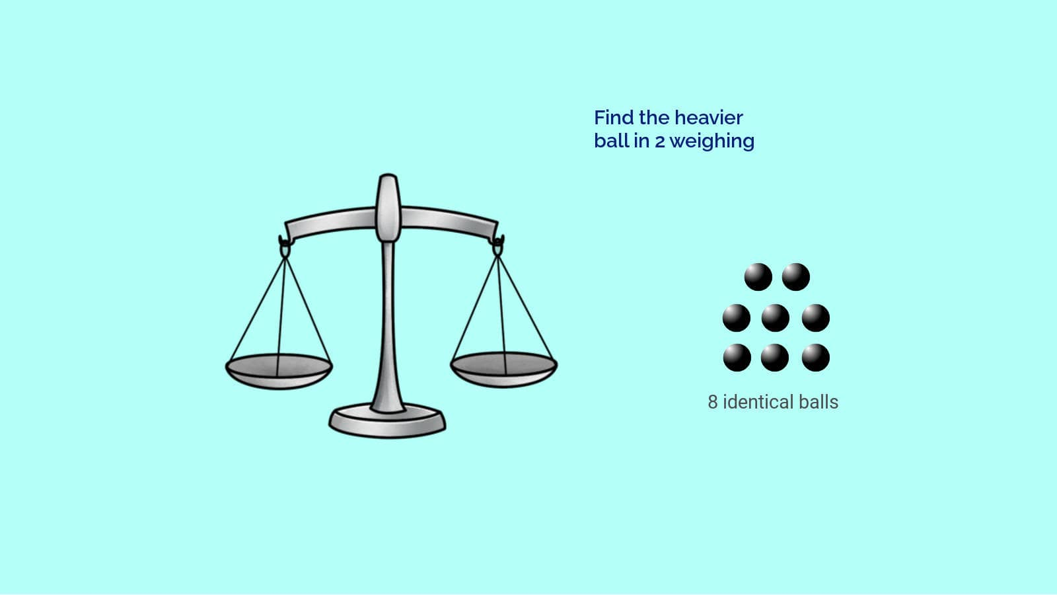


Slide 5
Logic
Patience
Precision
Patterns
Critical Thinking
Perseverance
Enjoyment
Teamwork
Proper Communication

Slide 6
Report Writing

Slide 7

Project Document
Cover Page Acknowledgments Abstract Table of Contents List of Figures List of Tables Chapter 1: Introduction Chapter 2: Literature Review Chapter 3: Design Chapter 4: Results Chapter 5: Conclusion References Appendix

Slide 8
Project Management Infographics
Abstract
Describe your project briefly in few paragraphs.
The abstract should not exceed one page.

Slide 9
Abstract
Motivation: Why do we care about the problem and the results? This section should include the importance of your work, and the impact it might have if successful.
Problem statement: What problem are you trying to solve?
Approach: How did you go about solving or making progress on the problem? Did you use simulation, analytic models, prototype construction, or analysis of field data for an actual product?
Results: What's the answer? Specifically, most good papers conclude that something is so many percent faster, cheaper, smaller, or otherwise better than something else. Put the result there, in numbers. Avoid vague, hand-waving results such as "very", "small", or "significant."
Conclusions: What are the implications of your answer? Are your results general, potentially generalizable, or specific to a particular case?

Slide 10
Project Document
Cover Page Acknowledgments Abstract Table of Contents List of Figures List of Tables Chapter 1: Introduction Chapter 2: Literature Review Chapter 3: Design Chapter 4: Results Chapter 5: Conclusion References Appendix

Slide 11
How to create a table of contents in Word

Slide 12
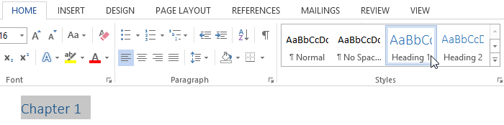
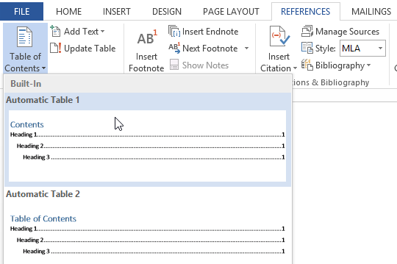
Step 1: Apply heading styles
To apply a heading style, select the text you want to format, then choose the desired heading in the Styles group on the Home tab. You can do that for chapters and subchapters.
Step 2: Insert the table of contents
Navigate to the References tab on the Ribbon, then click the Table of Contents command. Select a built-in table from the menu that appears, and the table of contents will appear in your document.

Slide 13
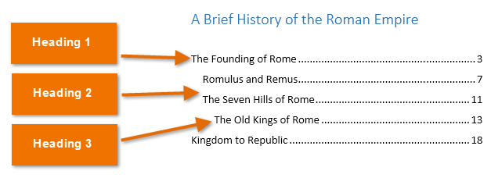

Slide 14
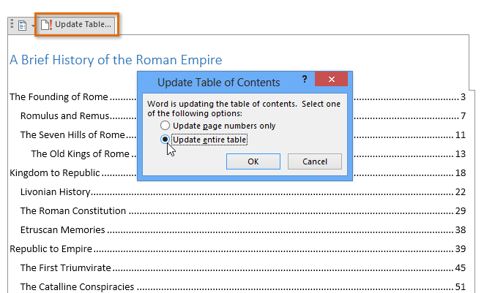
Step 3: Update as needed
If you edit or add to your document, it's easy to update the table of contents. Just select the table of contents, click Update Table, and choose Update Entire Table in the dialog box that appears. The table of contents will then update to reflect any changes.

Slide 15
How to create Figure Captions and a List of Figures

Slide 16
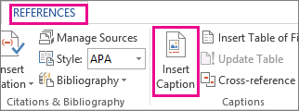
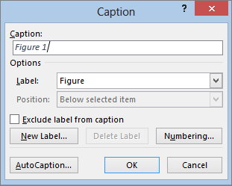
Step 1: The Insert Caption
Click the picture you want to add a caption to.
Click References > Insert Caption.
3. To use the default label (Figure), type your caption in the Caption box.

Slide 17
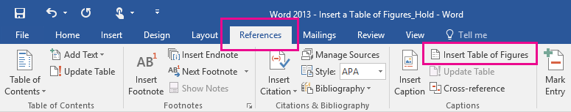
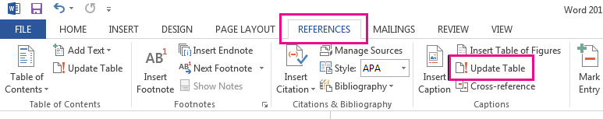
Step 2: A table of figures
Click in your document where you want to insert the table of figures.
Step 3: Update a table of figures
If you add, delete, change, or move captions, use Update Table so the table of figures reflects your changes.

Slide 18
Project Document
Cover Page Acknowledgments Abstract Table of Contents List of Figures List of Tables Chapter 1: Introduction Chapter 2: Literature Review Chapter 3: Design Chapter 4: Results Chapter 5: Conclusion References Appendix

Slide 19
Main Chapters
Introduction
It provides an overview of the project's scope and objectives

Slide 20
Introduction
Background of the project (Motivation e.g. why is the design important)
Objectives of the project and some description, including the
design requirements.

Slide 21
Design Requirements

Slide 22


Design Requirements
If you are designing a baseball bat, your design requirements might be that the bat needs to be:
Less than 1.5 pounds.
Made out of a material approved by the league.
Able to hit a baseball without breaking.
If you are designing a better form of transportation for students to get to school, your design requirements might be that the transportation needs to be:
Free for students.
Quick: less than one hour round-trip.
Safe.

Slide 23
Design Requirements
Types of Design Requirement for
General Products
Types of Design Requirements for
Software Programs

Slide 24
Introduction
Background of the project (Motivation e.g. why is the design important)
Objectives of the project and some description, including the
design requirements.
3.Design achieved (brief description)

Slide 25
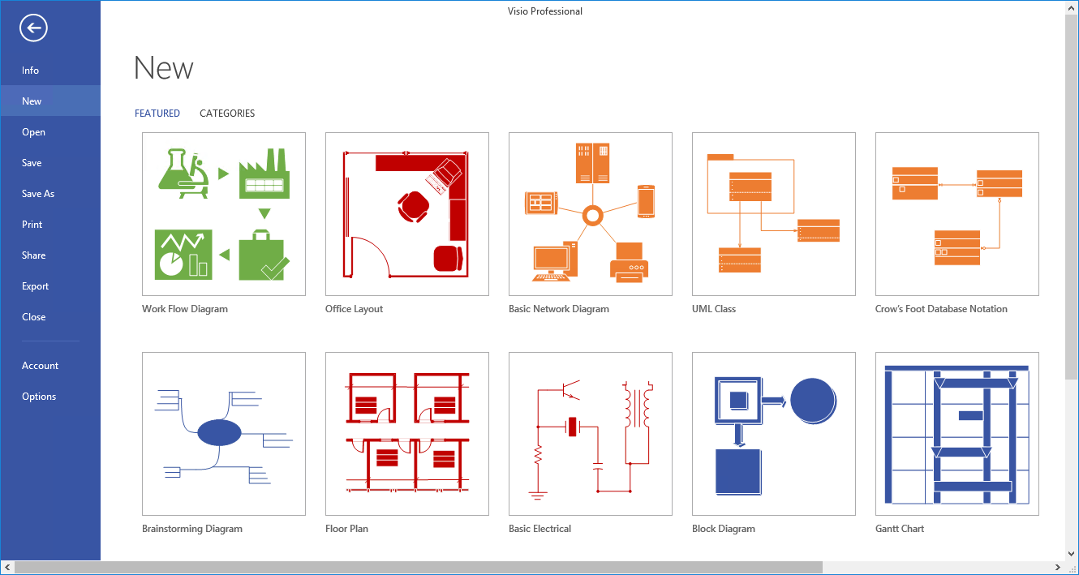
VISIO

Slide 26
Introduction
Background of the project (Motivation e.g. why is the design important)
Objectives of the project and some description, including the
design requirements.
3.Design achieved (brief description)
4.Indicate who exactly in the group is responsible for what.
5.Organization of the rest of the documentation.

Slide 27
Project Schedule
 | Q1 2021 |  |  | Q2 2021 |  |  | Q3 2021 |  |  | Q4 2021
 | Jan | Feb | Mar | Apr | May | June | July | Aug | Sep | Oct | Nov | Dec
Task A
Task B
Task C
Person 1
Person 2
Person 3
Task A
Task B
Task C

Slide 28
Main Chapters
Literature Review
Introduction
It provides an overview of the project's scope and objectives
Discusses relevant theories, methodologies, and previous projects in the same domain.

Slide 29

Background and Literature Review
Review relevant literature on the topic.
Discuss existing theories, methodologies, and technologies related to both simulation and hardware aspects.

Slide 30
Main Chapters
Design
Literature Review
Introduction
It provides an overview of the project's scope and objectives
Discusses relevant theories, methodologies, and previous projects in the same domain.
Details the
design
process

Slide 31
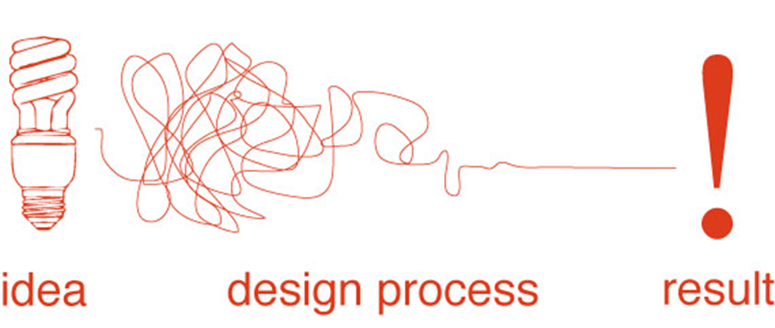

Slide 32
Design Chapter
Hardware Design and Implementation
Coding and Software Development
• Describe the hardware design and components used.
• Explain the physical setup of the hardware.
• Discuss any challenges faced during hardware implementation.
• Include photographs, diagrams, or schematics of the hardware setup.
• Describe the coding and software development.
• Explain the programming languages and tools used.
• Provide code flow charts or algorithms
• Discuss the coding challenges and solutions.

Slide 33
Main Chapters
Results
Design
Literature Review
Introduction
Includes data collected during testing and experimentation, as well as any simulations or prototypes developed
Provides an overview of the project's scope and objectives
Discusses relevant theories, methodologies, and previous projects in the same domain
Details the
design
Process

Slide 34
Experiment/Simulation Results Discussion: Prototype Setup Hardware Software Validation of requirements Discuss and analyze whether the requirements are met
Results
• Present the results of testing and validation procedures for both the simulation and hardware.
• Include data, graphs, and tables to support your findings.
• Discuss the performance and functionality of the integrated system.
• Use a table to summarize that requirements were met.

Slide 35
Main Chapters
Conclusion
Results
Design
Literature Review
Introduction
Provides an overview of the project's scope and objectives
Discusses relevant theories, methodologies, and previous projects in the same domain
Details the
design
Process
Includes data collected during testing and experimentation, as well as any simulations or prototypes developed
Revisit the project's objectives and discusses how well they were achieved

Slide 36
Project Document
Cover Page Acknowledgments Abstract Table of Contents List of Figures List of Tables Chapter 1: Introduction Chapter 2: Literature Review Chapter 3: Design Chapter 4: Results Chapter 5: Conclusion References Appendix

Slide 37

References
Follow a format consistent with IEEE guidelines and utilize conference and journal papers for your reference list
Example IEEE Reference for a Journal Paper:
M. Smith and J. Doe, "A Novel Approach to Renewable Energy Integration," IEEE Transactions on Sustainable Energy, vol. 5, no. 2, pp. 450-458, Apr. 2018. doi: 10.1109/TSTE.2017.2785090.
Author(s): M. Smith and J. Doe are the authors of the paper.
Title of the Paper: "A Novel Approach to Renewable Energy Integration" is the title of the journal paper.
Title of the Journal: "IEEE Transactions on Sustainable Energy" is the name of the journal where the paper is published.
Volume and Issue: "vol. 5, no. 2" indicates that this is volume 5, issue 2 of the journal.
Page Numbers: "pp. 450-458" specifies the page range of the article within the journal.
Month and Year: "Apr. 2018" represents the publication date of the paper.
DOI (Digital Object Identifier): "doi: 10.1109/TSTE.2017.2785090" is the DOI

Slide 38
Appendices
These are detailed documentation of points mentioned in the report (e.g. technical data, questionnaires, chart …. etc.) which are considered supplementary information but too long or not quite relevant enough to include in the main body of the report.
Appendices may be labeled with letters as Appendix A, Appendix B, and so on.
Appendix A: CODE

Slide 39
Graph/Table Description

Slide 40
Graphs
Figure 1: ……………………………………………..

Slide 41
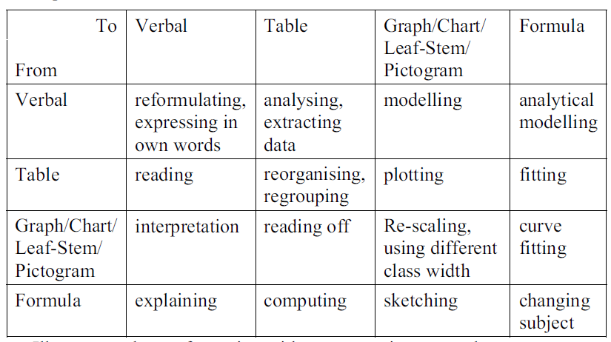
The table below gives different forms of representing data and the skill required to transform from one format to the other.

Slide 42
You are presented with a visual representation of information, such as a graph, chart, table, diagram, or map. Your job is to describe and interpret the information in your own words.
This task assesses your ability to
Summarize data and provide an accurate description of trends, comparisons, and key features.
Results Discussion

Slide 43
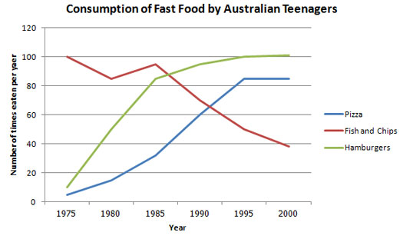
The line graph below shows changes in the amount and type of fast food consumed by Australian teenagers from 1975 to 2000.
Summarize the information by selecting and reporting the main features and make comparisons where relevant.
Write at least 150 words.

Slide 44
There are three basic things you need to structure
Introduce the graph
Give an overview
Give the detail

Slide 45
1.Introduce the graph
The line graph compares the fast food consumption of teenagers in Australia between 1975 and 2000, a period of 25 years.

Slide 46
2.Give an overview
state what the main trend or trends in the graph are. Don’t give detail– you are just looking for something that describes what is happening overall.
Overall, the consumption of fish and chips declined over the period, whereas the amount of pizza and hamburgers that were eaten increased.

Slide 47
3. Give the Detail
You can now give more specific detail in the body paragraphs.
The key to organizing your body paragraphs is to group data together where there are patterns.
To do this you need to identify any similarities and differences.

Slide 48
3. Give the Detail
In 1975, the most popular fast food with Australian teenagers was fish and chips, being eaten 100 times a year. This was far higher than Pizza and hamburgers, which were consumed approximately 5 times a year. However, apart from a brief rise again from 1980 to 1985, the consumption of fish and chips gradually declined over the 25 year timescale to finish at just under 40.
In sharp contrast to this, teenagers ate the other two fast foods at much higher levels. Pizza consumption increased gradually until it overtook the consumption of fish and chips in 1990. It then levelled off from 1995 to 2000. The biggest rise was seen in hamburgers as the occasions they were eaten increased sharply throughout the 1970’s and 1980’s, exceeding that of fish and chips in 1985. It finished at the same level that fish and chips began, with consumption at 100 times a year.

Slide 49
The line graph compares the fast food consumption of teenagers in Australia between 1975 and 2000, a period of 25 years. Overall, the consumption of fish and chips declined over the period, whereas the amount of pizza and hamburgers that were eaten increased.
In 1975, the most popular fast food with Australian teenagers was fish and chips, being eaten 100 times a year. This was far higher than Pizza and hamburgers, which were consumed approximately 5 times a year. However, apart from a brief rise again from 1980 to 1985, the consumption of fish and chips gradually declined over the 25 year timescale to finish at just under 40.
In sharp contrast to this, teenagers ate the other two fast foods at much higher levels. Pizza consumption increased gradually until it overtook the consumption of fish and chips in 1990. It then levelled off from 1995 to 2000. The biggest rise was seen in hamburgers as the occasions they were eaten increased sharply throughout the 1970’s and 1980’s, exceeding that of fish and chips in 1985. It finished at the same level that fish and chips began, with consumption at 100 times a year.

Slide 50
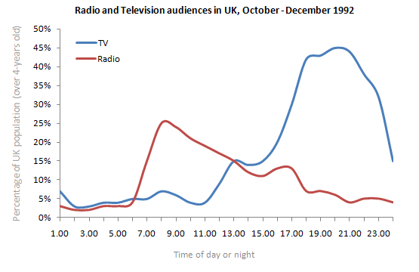
You should spend about 20 minutes on this task. The graph below shows radio and television audiences throughout the day in 1992. Write a report for a university lecturer describing the information shown below. Write at least 150 words.

Slide 51
Start Working- Template

Slide 52
Technical Writing Workshop
From Ideas to Documents

